Slide 1
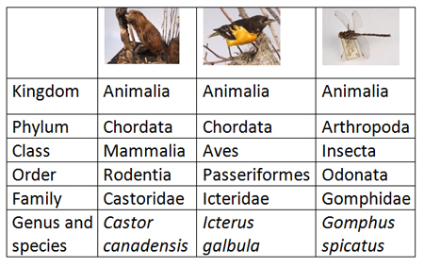
Common medical equipment nomenclature systems
Purpose of a nomenclature system
Application of a nomenclature within the hospital (standard equipment lists)
UNMDS
GMDS
17.3.4 Identify common medical equipment nomenclature systems.
Unit C 17.3 Global Medical Equipment Regulations
Module 279-17-C Regulations, Standards and Ethics
©
dr. Chris R. Mol, BME, NORTEC, 2015

Slide 2
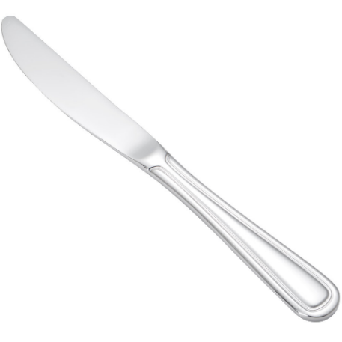
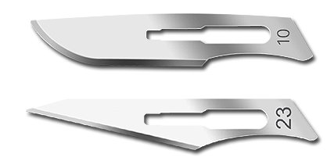
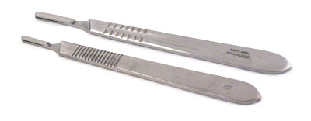
What is in a name ?
Which knife did I mean when I talked about a ‘knife’ ?
©
Nomen Clature Systems
dr. Chris R. Mol, BME, NORTEC, 2015

Slide 3
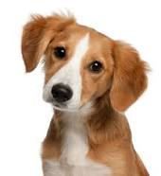
Nomen clature
Naming "things" is a part of general human communication using words and language. There are many different languages and names, that easily lead to misunderstanding and confusion when talking about these things/objects.
For scientific applications where precise understanding is critical, name giving systems have been developed that more precisely identify an object.
Note: this is not the identification of an individual object (a ‘personal’ ‘Name’ like Snoopy) but the name of the ‘genus’ (kind) of the object: in this case a ‘dog’ or better, the ‘normal house dog’ (‘Canis lupus familiaris’). This is known as a ‘generic name’.
A Nomenclature is a (‘name giving’) system of names or terms, or the rules for forming these terms in a particular field of sciences.
©
Nomen Clature Systems
dr. Chris R. Mol, BME, NORTEC, 2015

Slide 4
Global Medical Device Nomenclature (GMDN)
Global Medical Device Nomenclature (GMDN) is a system of internationally agreed generic descriptors used to identify all medical device products.
The main purpose of the GMDN is to provide all parties involved with a single generic naming system that will support patient safety.
Medical device experts from around the world compiled the GMDN, based on the international standard ISO 15225, which gives general rules for Nomenclature systems. The work was mandated by the European Commission in 1993.
The GMDN is used (amongst others) in the European Databank on Medical Devices which has been established by the European Commission to strengthen market surveillance and vigilance
©
Nomen Clature Systems
dr. Chris R. Mol, BME, NORTEC, 2015

Slide 5
Global Medical Device Nomenclature (GMDN)
The GMDN, endorsed by the GHTF as the global nomenclature to be used by regulators for the classification and registration of medical devices, is intended:
1. to give a common generic description for every general term that describes characteristics of a medical device. This is to be used for identifying similar devices to those involved in an adverse incident report;
2. to identify a device, using the generic term, for having been awarded a specific design certificate;
3. to serve as a basis for e-commerce – to provide a generic basis for purchasing individual types of manufactured devices, by establishing a heading for comparison of products from different manufacturers.
©
Nomen Clature Systems
dr. Chris R. Mol, BME, NORTEC, 2015

Slide 6
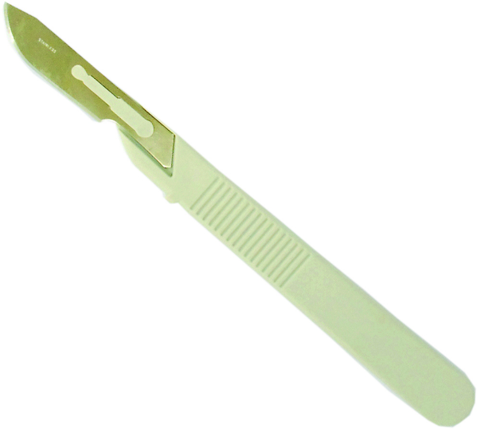
Global Medical Device Nomenclature (GMDN)
The GMDN term is in the form of a 5-digit numeric GMDN Code cross-referenced to a specific Term Name and Definition, with which all specific medical devices having substantially similar generic features, can be identified. An example:
GMDN Term Name - "Scalpel, single-use"
GMDN Code - "47569"
GMDN Definition - "A sterile, hand-held, manual surgical instrument constructed as a one-piece handle and scalpel blade (not an exchangeable component) used by the operator to manually cut or dissect tissue. The blade is typically made of high-grade stainless steel alloy or carbon steel and the handle is often made of plastic. This is a single-use device."
Now we know what a Scalpel is !
©
Nomen Clature Systems
dr. Chris R. Mol, BME, NORTEC, 2015

Slide 7
Global Medical Device Nomenclature (GMDN)
Development to date:
Establishment of GMDN Agency (2005)
18,933 Preferred Terms
1,980 Collective Terms (Device Attributes)
16 Categories (Scope)
Translation (ongoing)
English (Reference)
Japanese
Russian
Chinese (Mandarin)
20 EU Languages, including:
French
German
Italian
Portuguese
Spanish
Just started - Turkish, Serbo-Croat
©
Nomen Clature Systems
dr. Chris R. Mol, BME, NORTEC, 2015

Slide 8
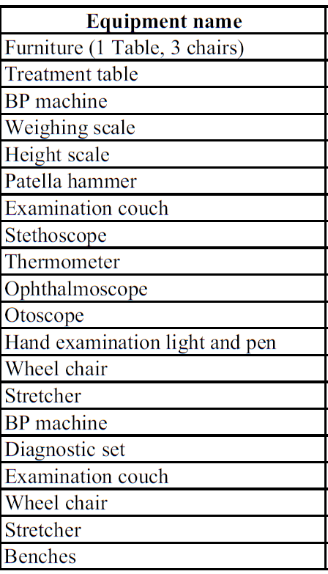
Application of a nomenclature within the hospital
When Zambia would comply with this nomenclature system, the GMDN should be the basis for the standard equipment lists.
Also, if Zambia would introduce adverse event reporting, this could be based on the GMDN system.
From:
Standard Equipment List for Level 3 hospitals, not yet based on the GMDN
Nomen Clature systems
dr. Chris R. Mol, BME, NORTEC, 2015

Slide 9
END
The creation of this presentation was supported by a grant from THET:
see https://www.thet.org/

